Slide 1


Doña Ana County Treasurer
Investment Report
Prepared by Eric L. Rodriguez
County Treasurer
March 12, 2024
Mid Year Review
FY 2024

Slide 2
Primary Objectives
Safety: Investments shall be undertaken in a manner that seeks to ensure the preservation of capital in the overall portfolio. The objective will be to mitigate credit risk and interest rate risk.
Liquidity: The investment portfolio shall remain sufficiently liquid to meet all operating requirements that may be reasonably anticipated.
Return: The investment portfolio shall be designed with the objective of attaining a market rate of return throughout budgetary and economic cycles.

Slide 5
Holdings

Slide 6
Maturity Distribution

Slide 7
Weighted Average Maturity
Weighted Average Maturity
As of 12/31/2023
Investment Type | FMV | Weighted Average Maturity | Fair Value*
CDs | 29,326,057.83 | 1.67 | 2
CDARS | 2,067,855.11 | 1.00 | 2
Money Market, Savings, & and Checking | 110,246,712.93 | 0.00 | 2
US Treasury Notes and Bonds | 3,045,646.26 | 2.48 | 1
Revenue Bond | 3,715,000.00 | 10.00 | 2
Municipal Bonds | 3,693,436.26 | 3.42 | 2
Tenn Valley Auth | 408,219.35 | 1.25 | 1
Federal Farm Credit | 39,927,212.66 | 1.42 | 1
Federal Home Loan Bank | 50,761,734.04 | 1.73 | 1
Fannie Mae | 7,073,624.07 | 3.22 | 1
Freddie Mac | 12,171,389.54 | 1.83 | 1
Farmer Mac | 1,967,420.00 | 0.42 | 1
 | 264,404,308.05 | 2.37
*Fair Market Measurements Using:
Quoted Prices in Active Markets for Identical Assets (Level 1)
Significant Other Observable Inputs (Level 2)
Estimated Value Ranges (Level 3)

Slide 8
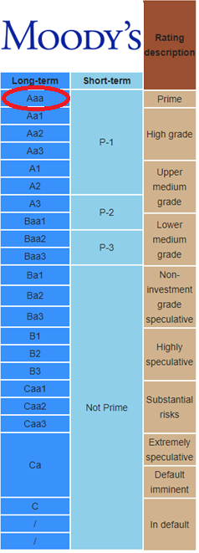
Credit Quality

Slide 9
Total Earnings Trend

Slide 10
5 Year Monthly Earnings Comparison

Slide 11
Investment Policy Compliance

Slide 12
Moving Forward
Strategy
  Continue to take advantage of recent rate increases. Focus on laddered portfolio.
  Manage and forecast cash flows to maximize on long term holdings
  Secure long calls or bullet holdings
  Increase Brokered CD holdings which carry minimal risk and have good spreads
  Expand duration benchmarks
Economic Factors to Consider
  2023 with unemployment near 50-year lows at 3.7% with wage growth at 4.1%
  Core Personal Consumption Expenditures Index, was 2.9% (target is 2%)
  3.2% GDP increase 2023 Q4- Expected decreases in 2024 to 1.5% growth
  “Powell reinforces position that the Fed is not ready to start cutting interest rates”- CNBC March 6, 2024

