Slide 1

Combating Illegal Dumping In Doña Ana County
**********
Creating the Illegal Dumping Partnership
Patrick Peck
Director, SCSWA
October 2018

Slide 2
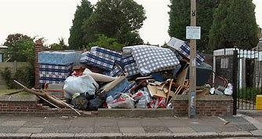
How It All Began
The Illegal Dumping Partnership (IDP) was created in 2011
  It started with a simple phone call between Bureau of Land Management & South Central Solid Waste Authority
    Doña Ana County was included in the first meeting
The founding members are
  Bureau of Land Management (BLM)
  South Central Solid Waste Authority (SCSWA)
  Doña Ana County (DAC)
In the beginning, BLM had funding to hire students over the summer to pick up trash.
They were looking for partners to help haul and dispose of the collected trash.
The 3 partners met and decided to pool their resources and develop an anti-illegal dumping campaign.

Slide 3
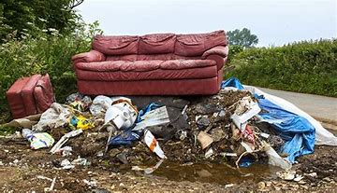
Resources
Each member was able to pledge resources
  BLM
    Labor, Funding, Enforcement
  DAC
    Codes, GIS Mapping, Community Groups, Political Support
  SCSWA
    Discounted Tipping Fees, Hauling, Equipment, Public Relations

Slide 4
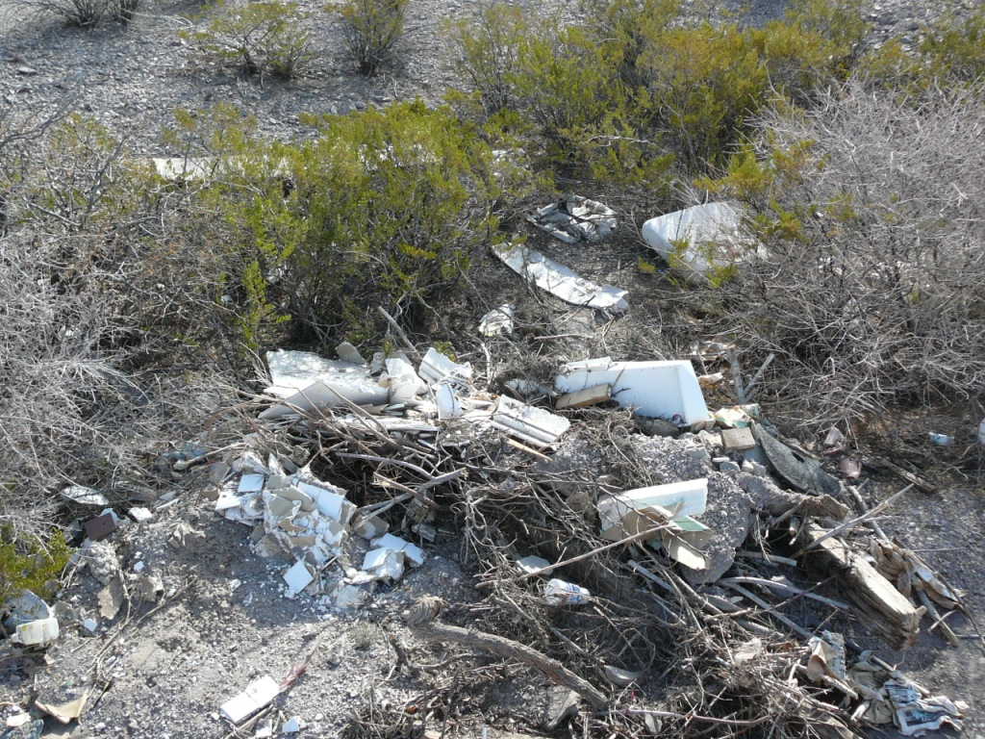
The Original Plan
Identify areas in the County that had illegal dumping
  Define a Targeted Area and Create Enforcement Zones
Provide
  Seasonal Labor to Clean Up the Area
  Education and Public Relations in Targeted Community
  Increase Patrols by Law Enforcement and Codes Officers
Publicize our success and gain additional support from communities and other agencies
  The Untrash Our Desert Summit was first held in the Fall of 2011
    Largest illegal dumping meeting ever held in the State

Slide 5
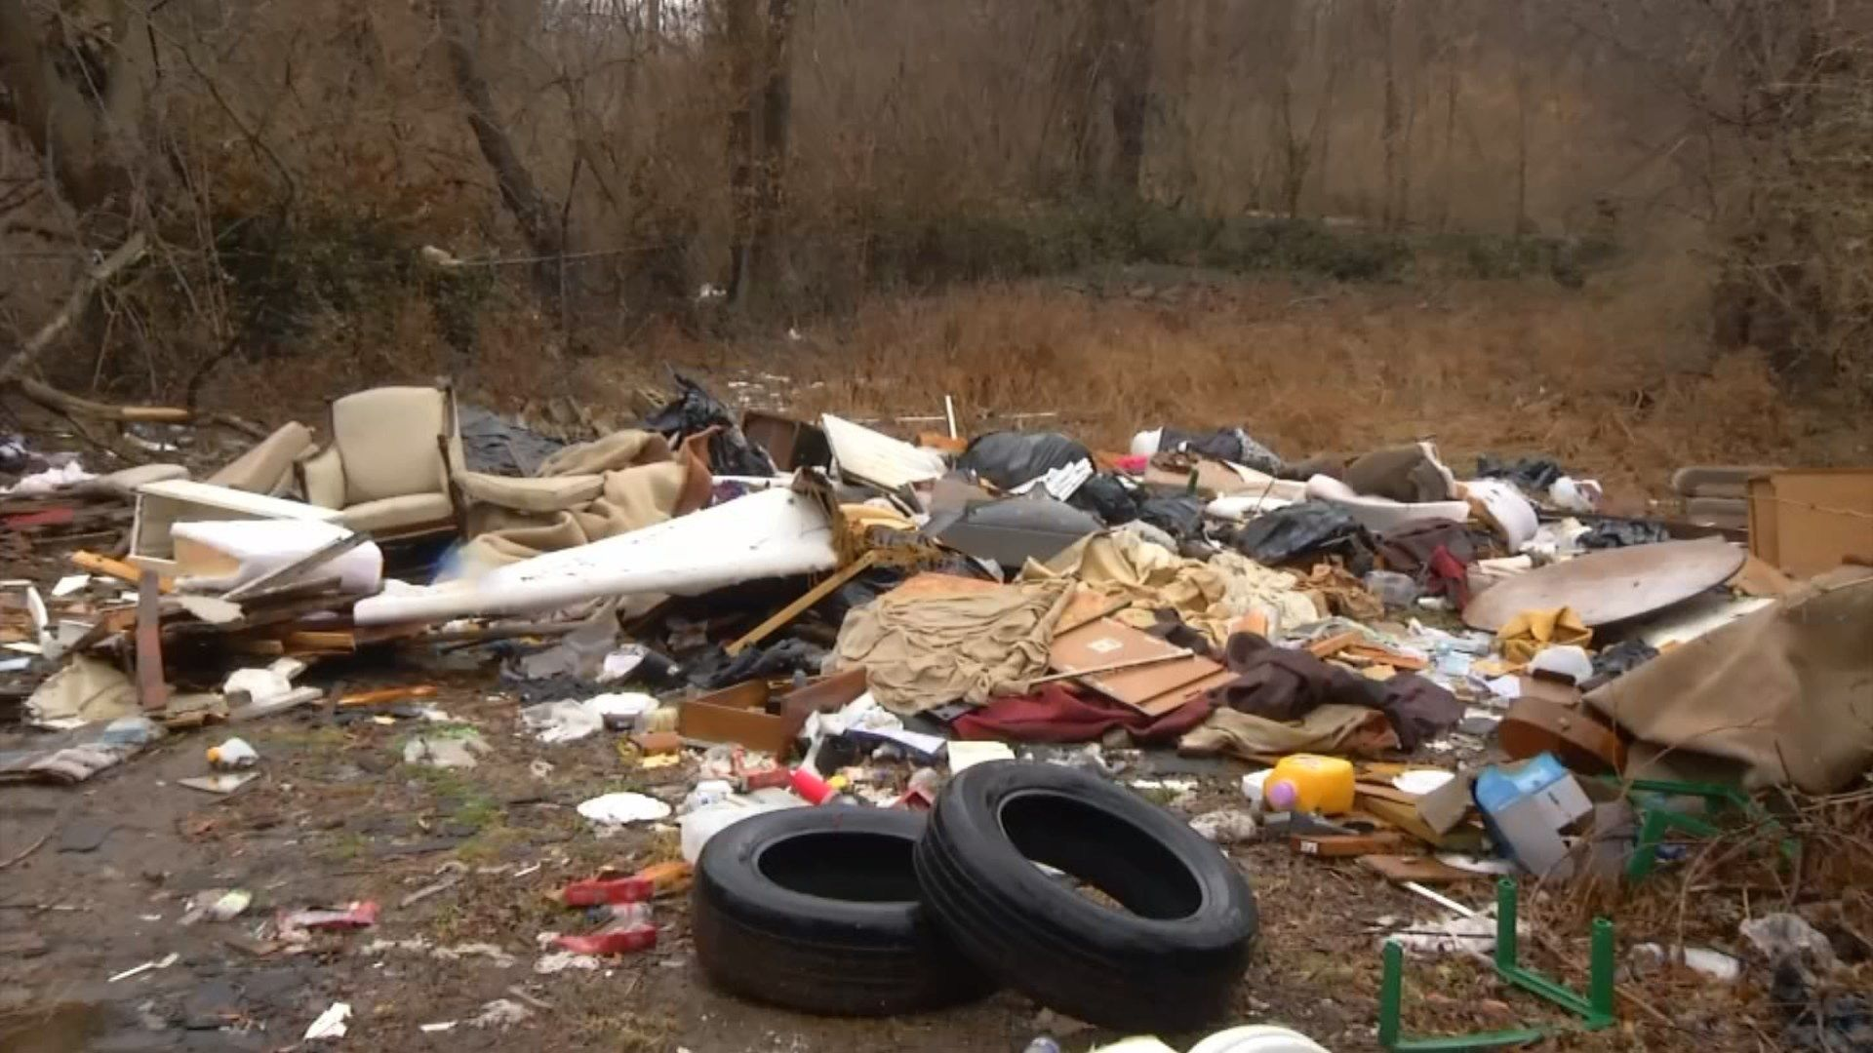
Additional Support
In 2012, we found three HHS community surveys that identified solid waste management and or trash to be a top 5 concern of residents in Doña Ana County
Utilized these surveys to gain political support
Began to develop a community-based program to address concerns
  A.C.E.S. ( Hybrid of an Animal Control program)
    Codes Officers go into communities to access code violations
      Go door to door
    Work with local community leaders to set up community clean up 2 weeks later
      SCSWA brings in roll-offs and sets up in community
    Codes goes back in one month and issue violations to those who don’t comply
    Codes has an ACES Calendar and it has clean ups every month of the year.

Slide 6
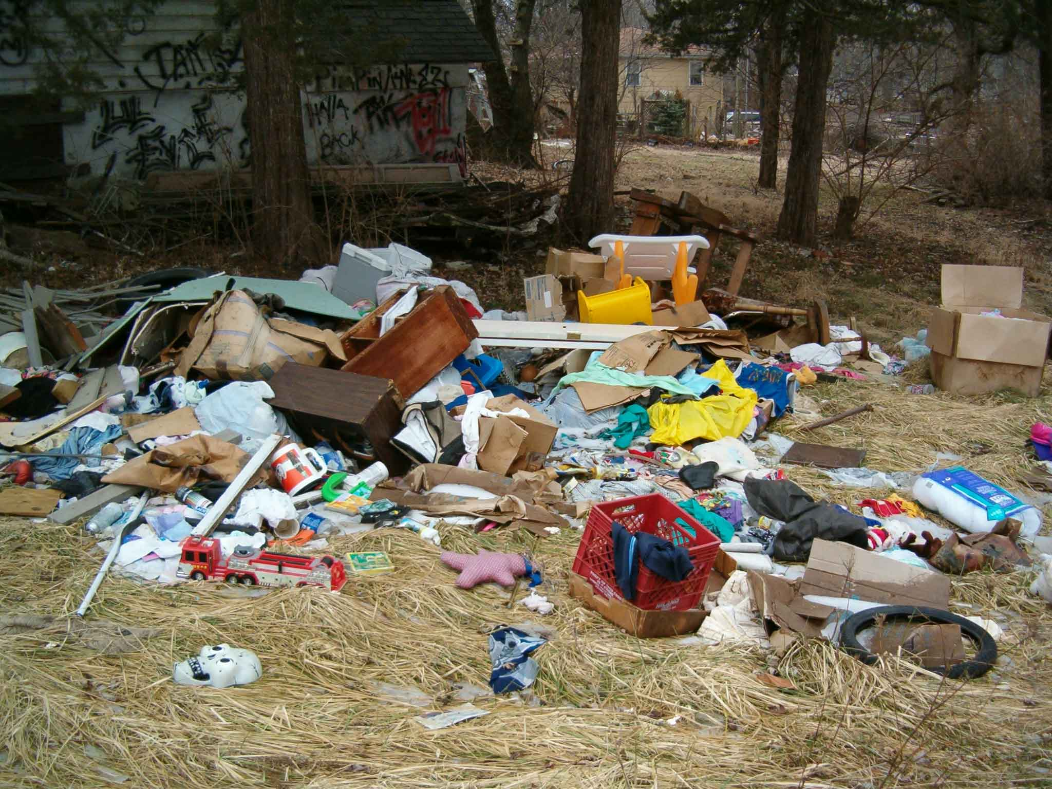
Published Results
Collecting the data and presentations are key to maintaining funding This report made it all the way to Washington D.C

Slide 7
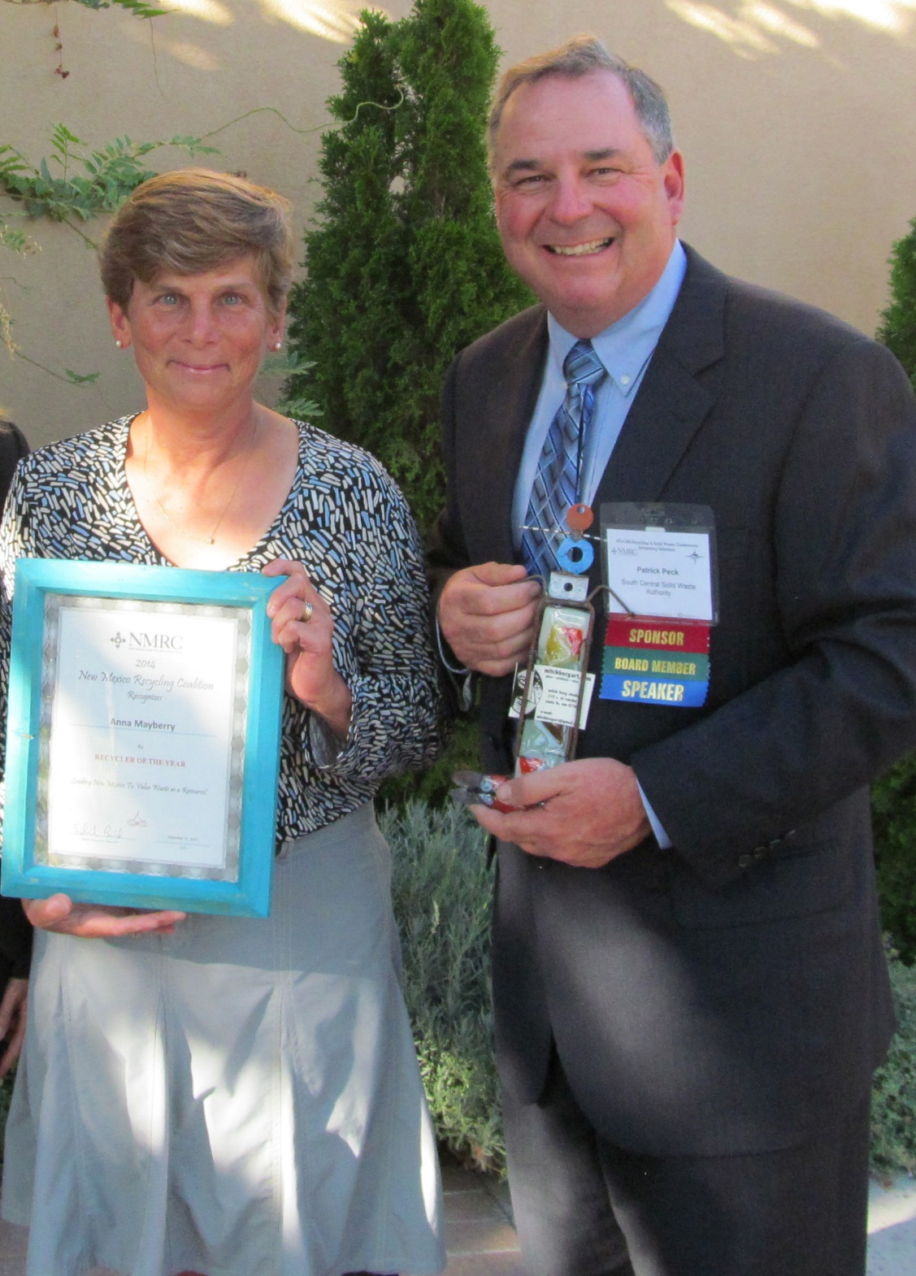
Getting the Work Done
  Work Crews
    don’t just talk about it do it
    Volunteers
      Labor is your biggest obstacle
    Policy
      SCSWA will wave tipping fees for any volunteer group
    Recognition
      Make sure to reward that hard work with local and state recognition

Slide 8

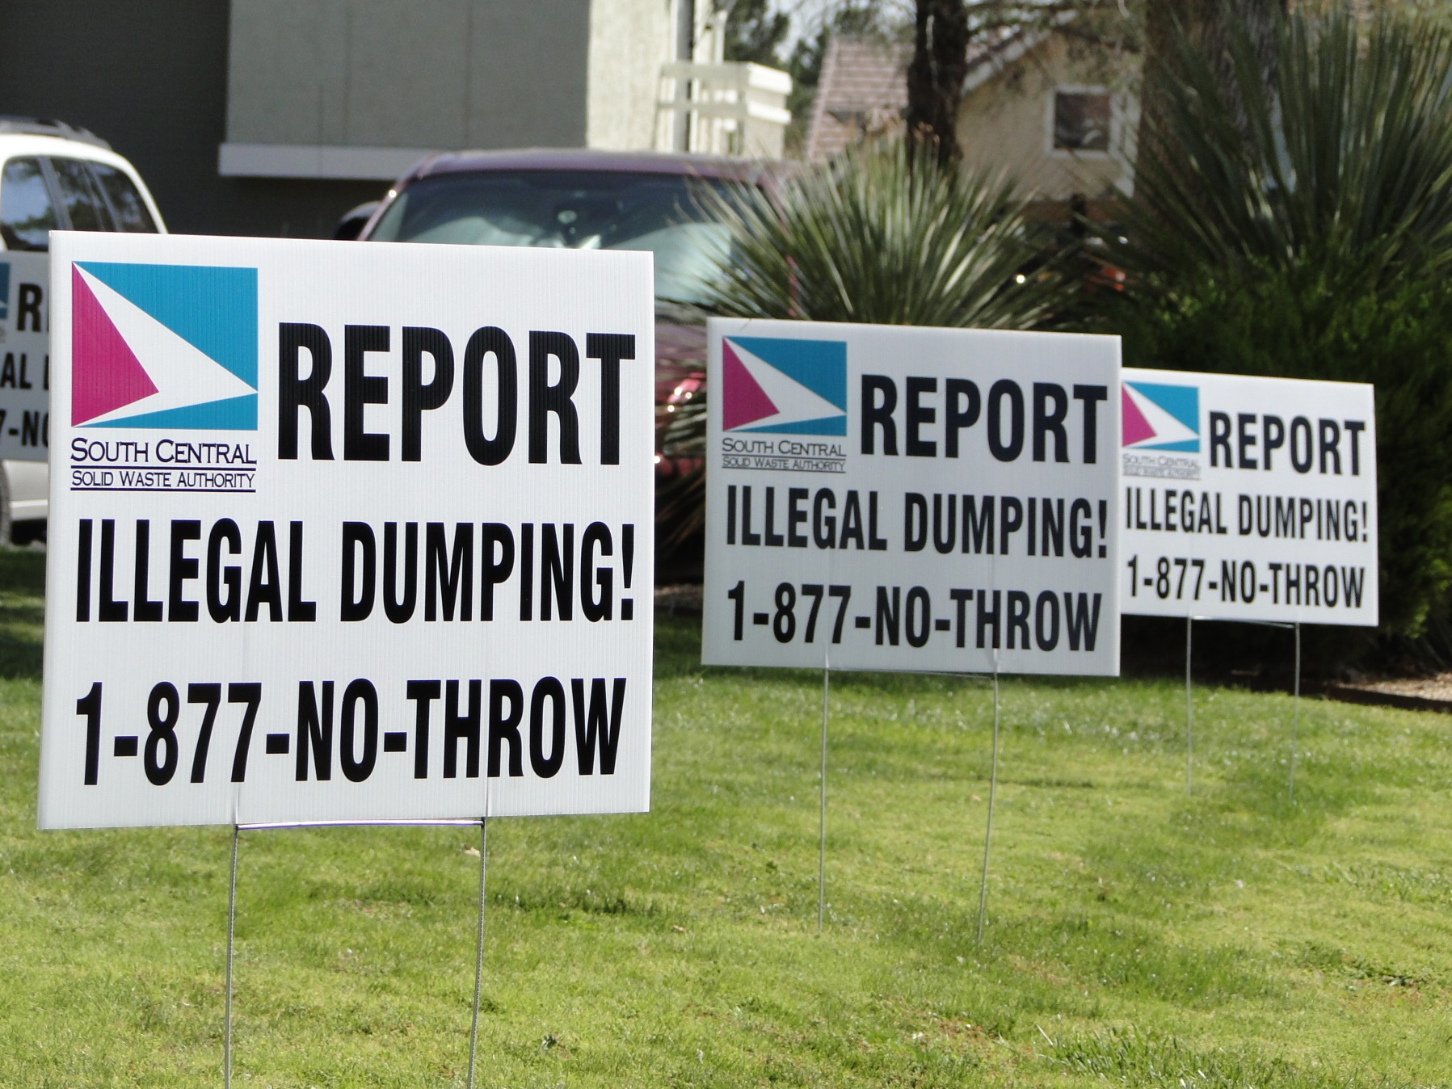

Getting the Word Out

Slide 9
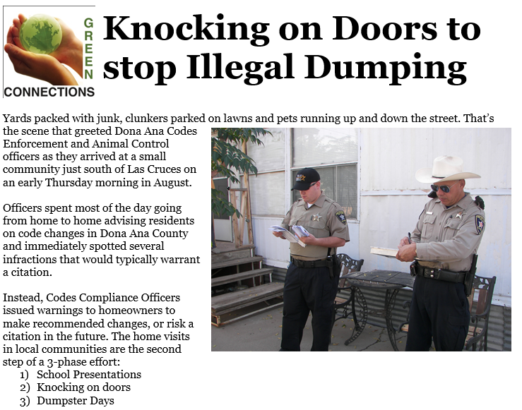
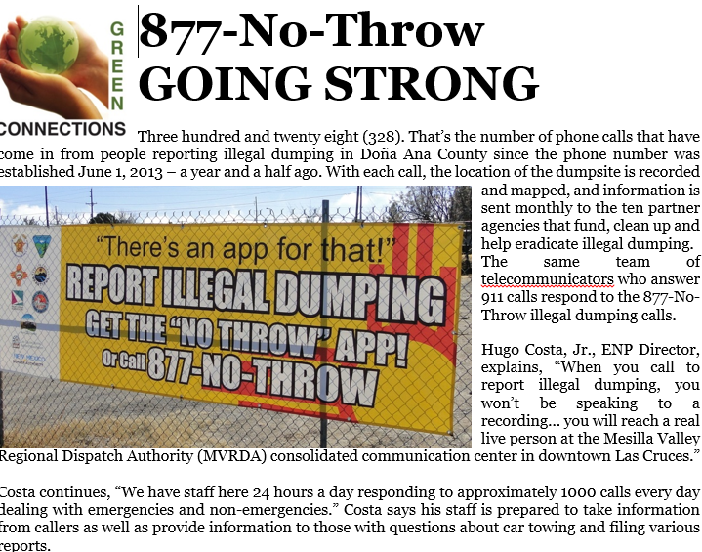
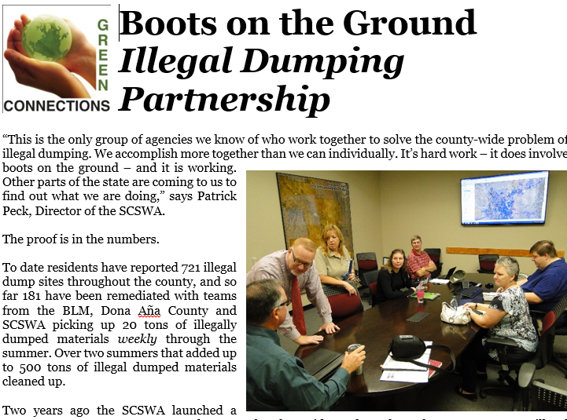
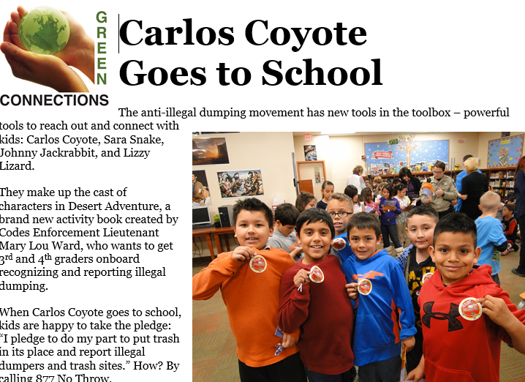
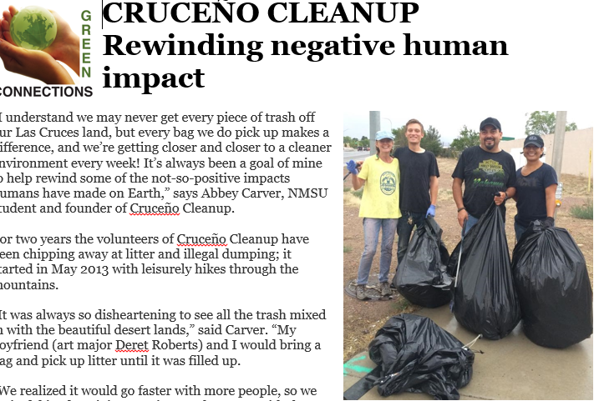
Newspaper articles
60 Articles – 7 years

Slide 10
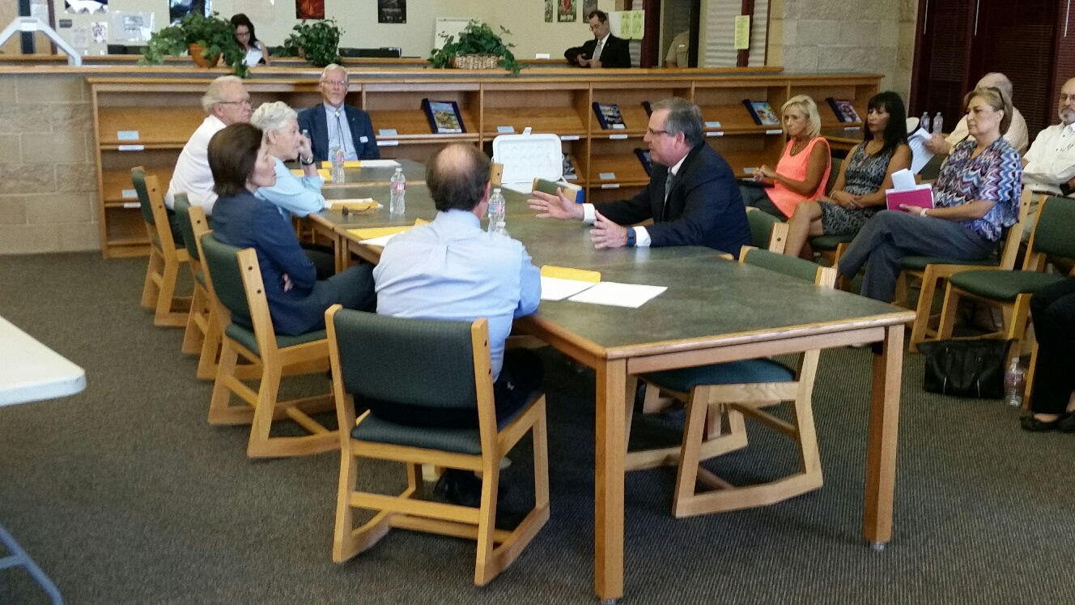
Mentor Other Communities
  Illegal Dumping is a State Wide Issue
    8 years on State RAID grant review committee
  Sharing of resources and ideas only makes the group strong and make illegal dumping harder
  Identify resources and Partners in your community to build a state wide illegal dumping coalition

Slide 11



Contact Information
Patrick Peck
Director, South Central Solid Waste Authority
575 528-3800
ppeck@las-cruces.org
Website: www.scswa.net
Facebook: @theSCSWA
Instagram: @SCSWARC

